Slide 1


ERP software implementation as SaaS
Group Number : 37
Guidance From: Prof. Satyadev Vyas
Project By:
130020107026 Darshit S. Jasani
130020107065 Miloni S. Patel
130020107086 Harshrajsinh V. Rathod

Slide 2
Introduction
The basic idea is to create a Website and SaaS which combines all the best features of the GTU website, the AIT website and user required features.
The website will runs on common web browsers and will be useful medium between faculty, HODs, administrative staff and the students.

Slide 3
Objectives
Faster delivery of any kind of Information related to College
Improved end user quality of experience
Simple User Interface
Appropriate Data Safeguarding measured
Social media integration

Slide 4
Related Background
If we visit college website, it’ll take a lot of time to find even small amount of information. Various data like exam dates and results are also not available in website.
Right now, Administration work is little time consuming. We will try our best to create swift way and paperless administration work.
Hence, the basic idea is to reduce the problems created while surfing the website and minimize the amount of effort the user has to put in to get the information.

Slide 5




Tools and Technology
Adobe Dreamweaver
Sublime
GNU Image Manipulation Program

Slide 6
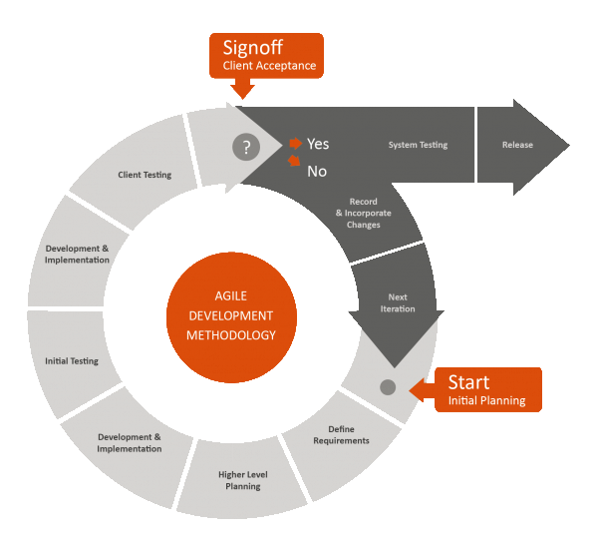
Methodology

Slide 7
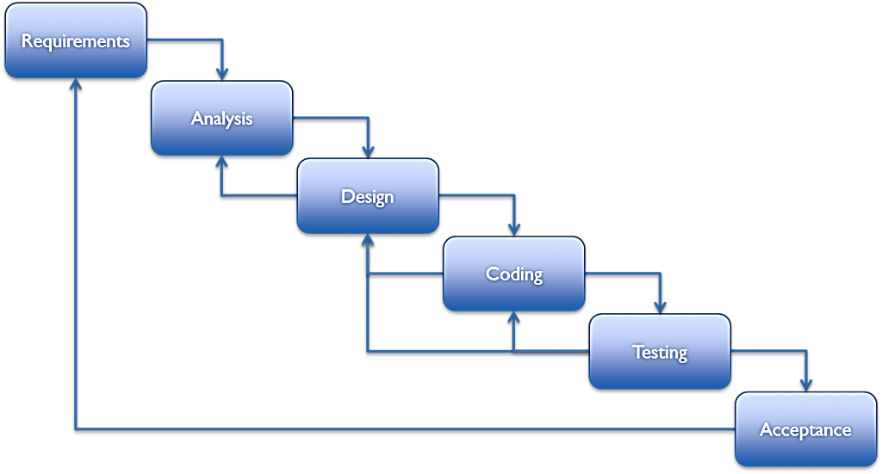
Methodology

Slide 8
Expected Outcomes
Immediacy: Instant availability of information
Compatibility across different browsers
Improve the visual design and content structuring-reduce clutter
Make core information available with reduced number of clicks
Paperless work for administration work.
Better coordination between Faculty and students.

Slide 9
Thank You

